Slide 1
MATH2010 Probability and STATISTICS
Le DUY DUNG
College of Engineering and Computer Science

Slide 2
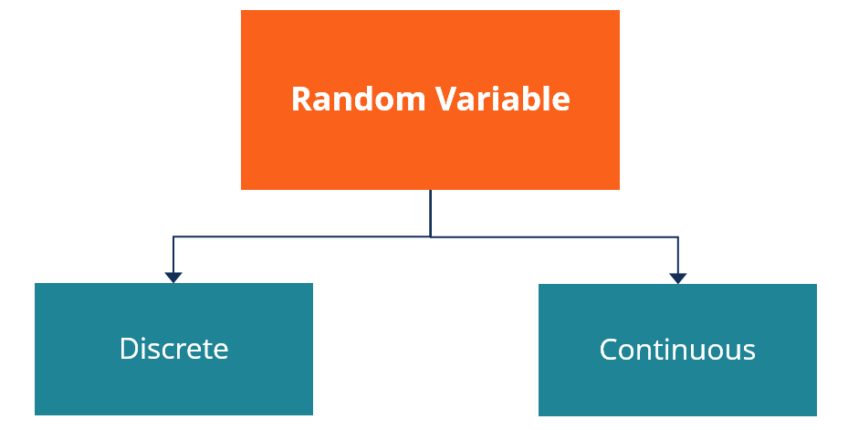
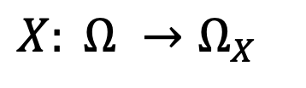
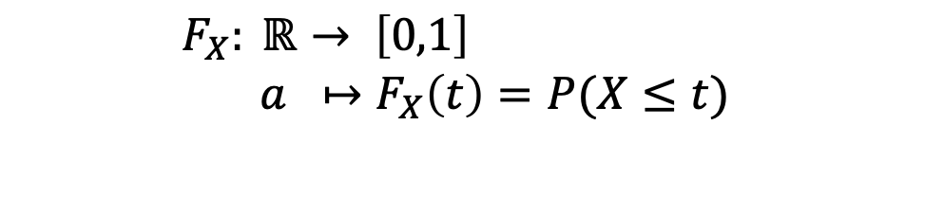
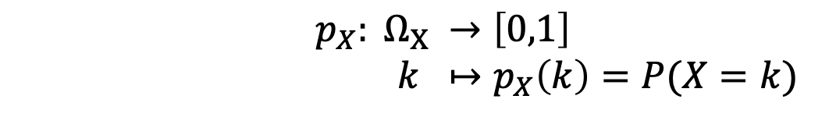
From Lecture 4
$$X: Ω →Ω_{X}$$
Probability Mass Function (PMF)
$p_{X}: Ω_{X} →\left[0,1\right]$
$k ↦p_{X}\left(k\right)=P(X=k)$
Cummulative Distribution Function (CDF)
$$F_{X}: ℝ→ \left[0,1\right]$$
$$a ↦F_{X}\left(t\right)=P(X≤t)$$

Slide 3
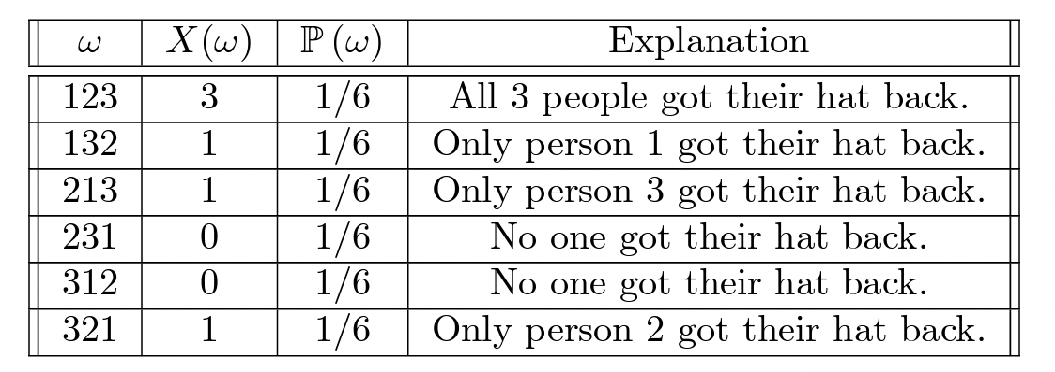
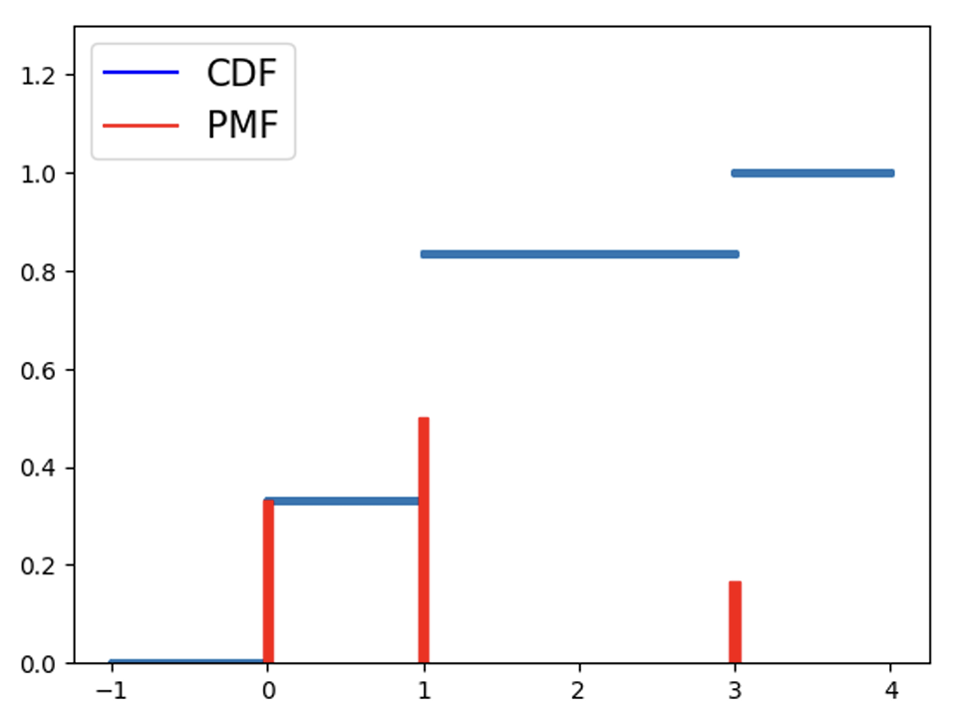
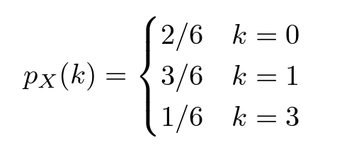
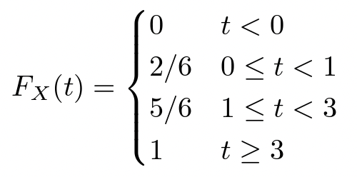

PMF and CDF
Example. Suppose there are three students, and their hats are returned randomly with each of the 3! permutations equally likely. Let $X$ be the number of hats returned to the correct owner.
PMF
CDF

Slide 4

CDF
For all $a≤ b$:
$P\left(a< X≤b \right)= F_{X}\left(b\right)− F_{X}(a)$

Slide 5
Learning Goals
Expectation of a discrete random variable
Linearity of expectation
Law of unconcious statistician
Variance and standard deviation

Slide 6
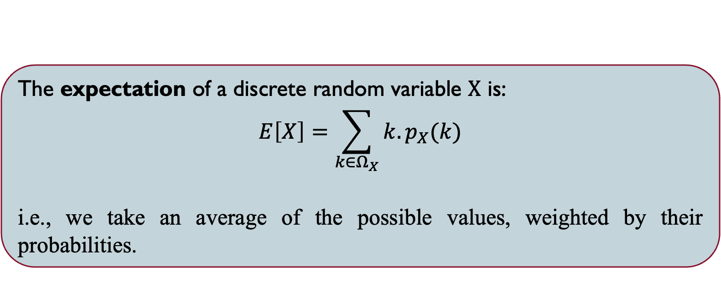
EXPECTATION
The expectation of a discrete random variable $X$ is:
$$E\left[X\right]=\sum_{k∈Ω_{X}}{k.p_{X}(k)}$$
i.e., we take an average of the possible values, weighted by their probabilities.

Slide 7


EXAMPLE
Suppose there are three students, and their hats are returned randomly with each of the 3! permutations equally likely. Let $X$ be the number of hats returned to the correct owner.
Find the expected number of people who got their hat back, $E(X)$?
$$Ω_{X}=\{0, 1, 3\}$$

Slide 8
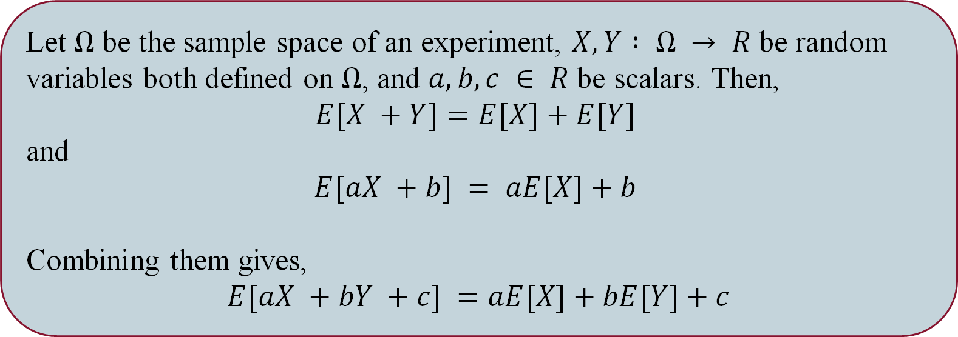
LIneariTY of Expectation
Let $Ω$ be the sample space of an experiment, $X,Y : Ω → R$ be random variables both defined on $Ω$, and $a,b,c ∈ R$ be scalars. Then,
$$E[X +Y]=E[X]+E[Y]$$
and
$$E[aX +b] = aE[X]+b$$
Combining them gives,
$$E[aX +bY +c] =aE[X]+bE[Y]+c$$

Slide 9
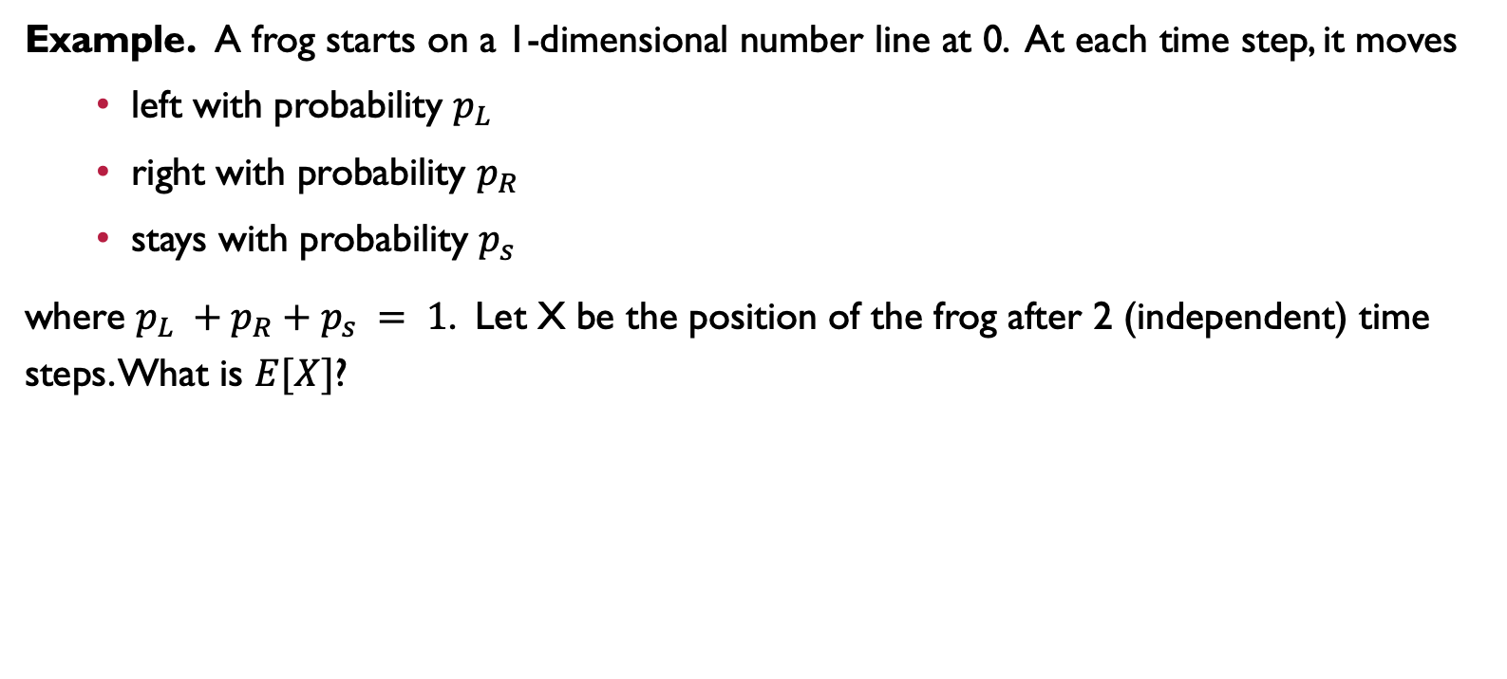
LIneariTY of Expectation
Example. A frog starts on a 1-dimensional number line at 0. At each time step, it moves
left with probability $p_{L}$
right with probability $p_{R}$
stays with probability $p_{s}$
where $p_{L} +p_{R}+p_{s} = 1$. Let X be the position of the frog after 2 (independent) time steps. What is $E[X]$?

Slide 10
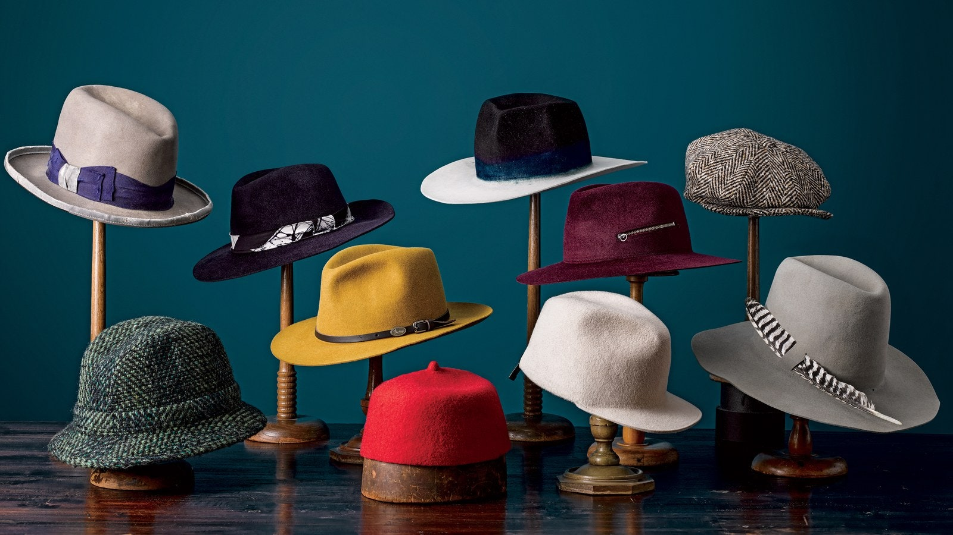

LIneariTY of Expectation
Example. Suppose $n$ people go to a party and leave their hat with the hat-check person. At the end of the party, she returns hats randomly and uniformly because she does not care about her job. Let $X$ be the number of people who get their original hat back. What is $E[X]$?

Slide 11
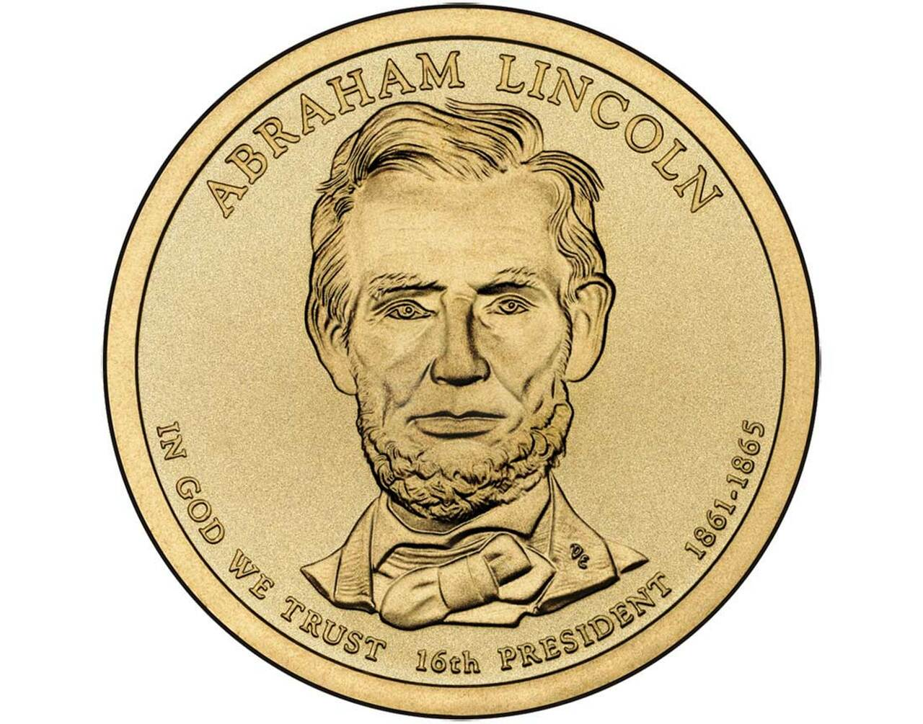
Practice: Suppose we flip a coin n = 100 times independently, where the probability of getting a head on each f lip is p = 0.23. What is the expected number of heads we get?

Slide 12
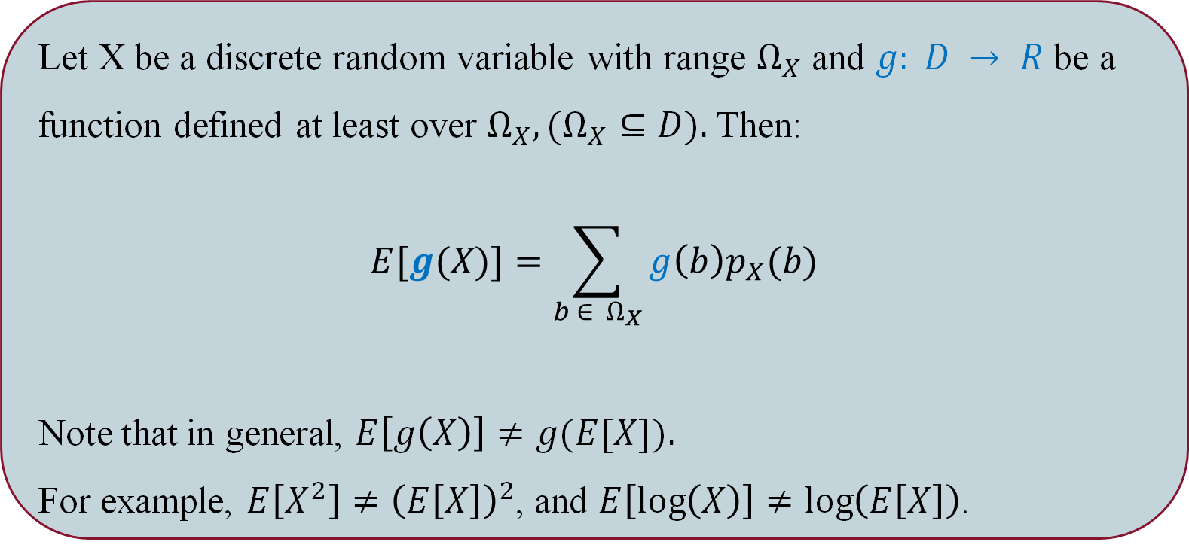
Law of Unconscious StatisTIcian
Let X be a discrete random variable with range $Ω_{X}$ and $g: D → R$ be a function defined at least over $Ω_{X}, (Ω_{X}⊆D).$Then:
$$E[g(X)]=\sum_{b ∈ { Ω}_{X}}{g\left(b\right)p_{X}(b)}$$
Note that in general, $E\left[g\left(X\right)\right]≠g(E[X]).$
For example, $E\left[X^{2}\right]≠{\left(E\left[X\right]\right)}^{2}$, and $E\left[\log\left(X\right)\right]≠\log\left(E\left[X\right]\right)$.

Slide 13
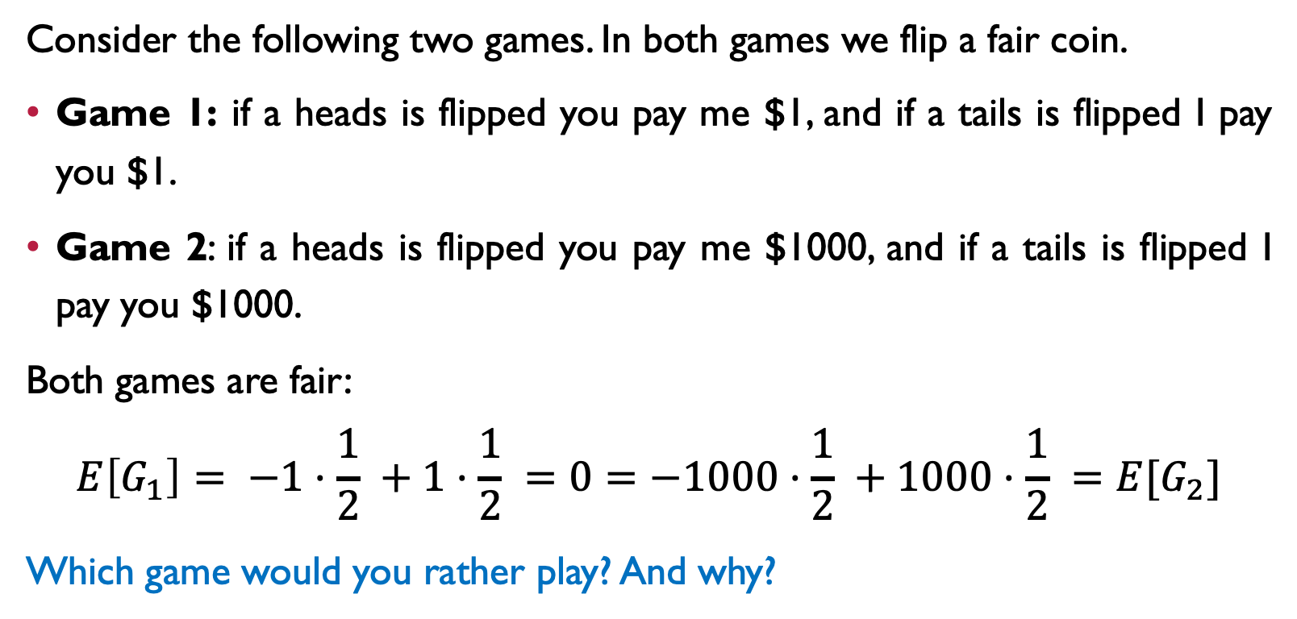
Variance
Consider the following two games. In both games we flip a fair coin.
Game 1: if a heads is flipped you pay me $1, and if a tails is flipped I pay you $1.
Game 2: if a heads is flipped you pay me $1000, and if a tails is flipped I pay you $1000.
Both games are fair:
$$E\left[G_{1}\right]= −1·\frac{1}{2} +1·\frac{1}{2} =0=−1000·\frac{1}{2} +1000·\frac{1}{2} =E[G_{2}]$$
Which game would you rather play? And why?

Slide 14
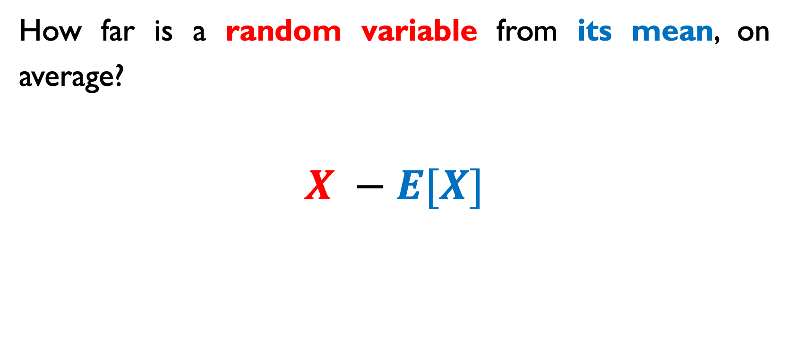
Variance (Intuition)
How far is a random variable from its mean, on average?
$$X −E[X]$$

Slide 15
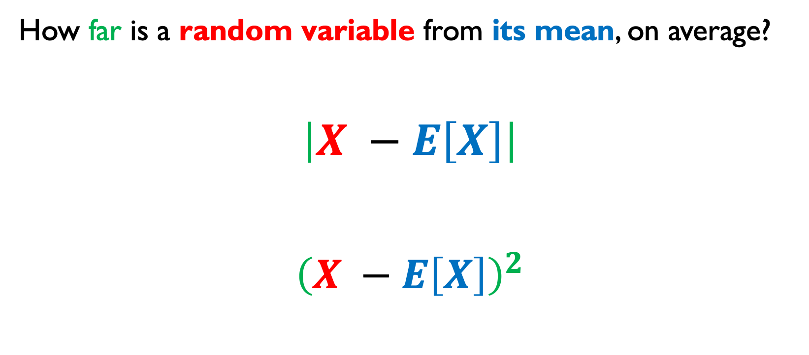
Variance (Intuition)
How far is a random variable from its mean, on average?
$$\left|X −E\left[X\right]\right|$$
$${\left(X −E\left[X\right]\right)}^{2}$$

Slide 16
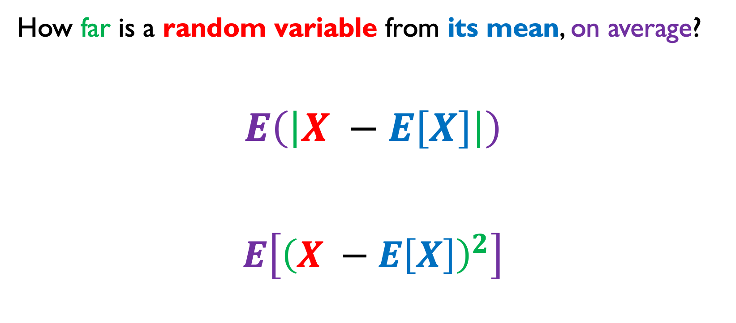
Variance (Intuition)
How far is a random variable from its mean, on average?
$$E\left(\left|X −E\left[X\right]\right|\right)$$
$$E\left[{\left(X −E\left[X\right]\right)}^{2}\right]$$

Slide 17
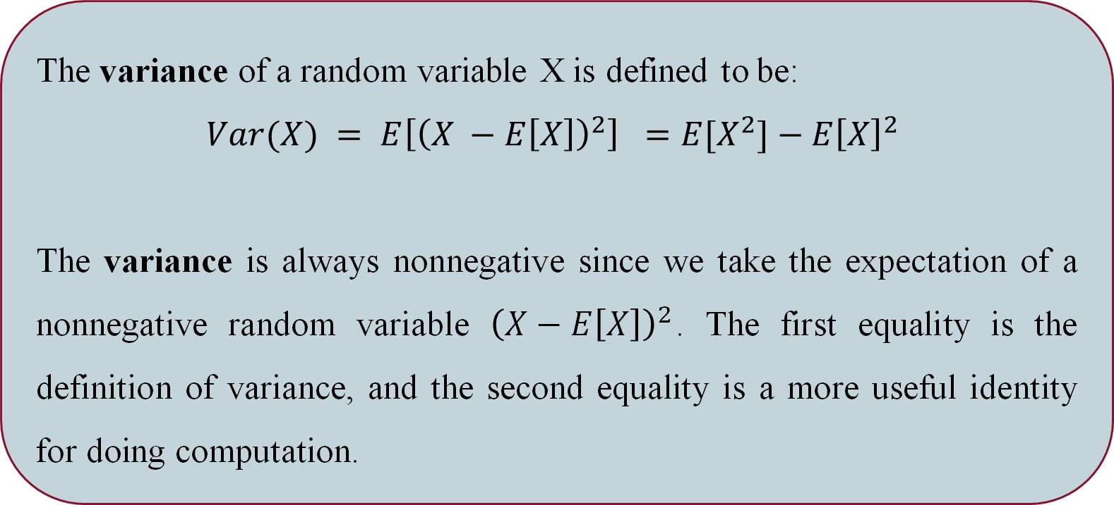
Variance
The variance of a random variable X is defined to be:
$$Var(X) = E\left[{\left(X −E\left[X\right]\right)}^{2}\right] =E[X^{2}]−E{\left[X\right]}^{2}$$
The variance is always nonnegative since we take the expectation of a nonnegative random variable ${\left(X−E\left[X\right]\right)}^{2}$. The first equality is the definition of variance, and the second equality is a more useful identity for doing computation.

Slide 18
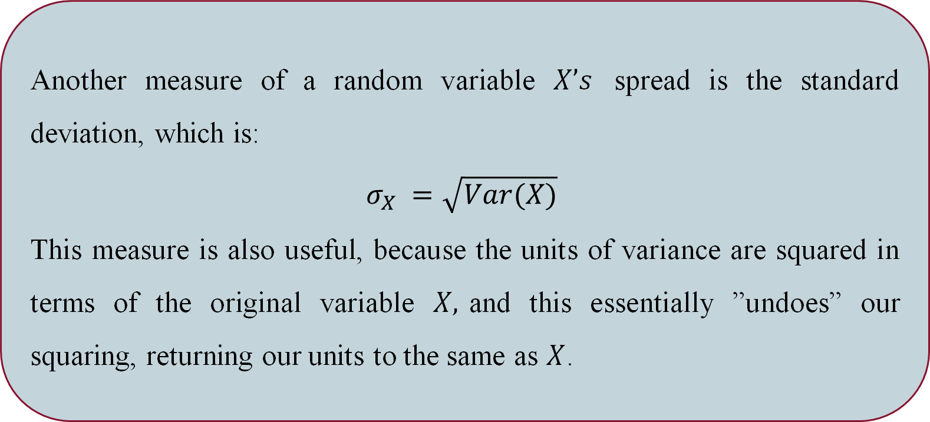
Standard Deviation
Another measure of a random variable $X’s$ spread is the standard deviation, which is:
$$σ_{X} =\sqrt{Var(X)}$$
This measure is also useful, because the units of variance are squared in terms of the original variable $X,$and this essentially ”undoes” our squaring, returning our units to the same as $X$.

Slide 19

Property of Variance
We can also show that for any scalar $a,b ∈ R$,
$$Var(aX +b) = a^{2}Var(X)$$

Slide 20

Variance
Let $X$ be the outcome of a fair 6-sided die roll. What is $Var(X)$?
Let’s say you play a casino game, where you must pay $10 to roll this die once, but earn twice the value of the roll. What are the expected value and variance of your earnings?

Slide 21
SUmmary
PMF
CDF
Expectation
Variance

